Slide 1
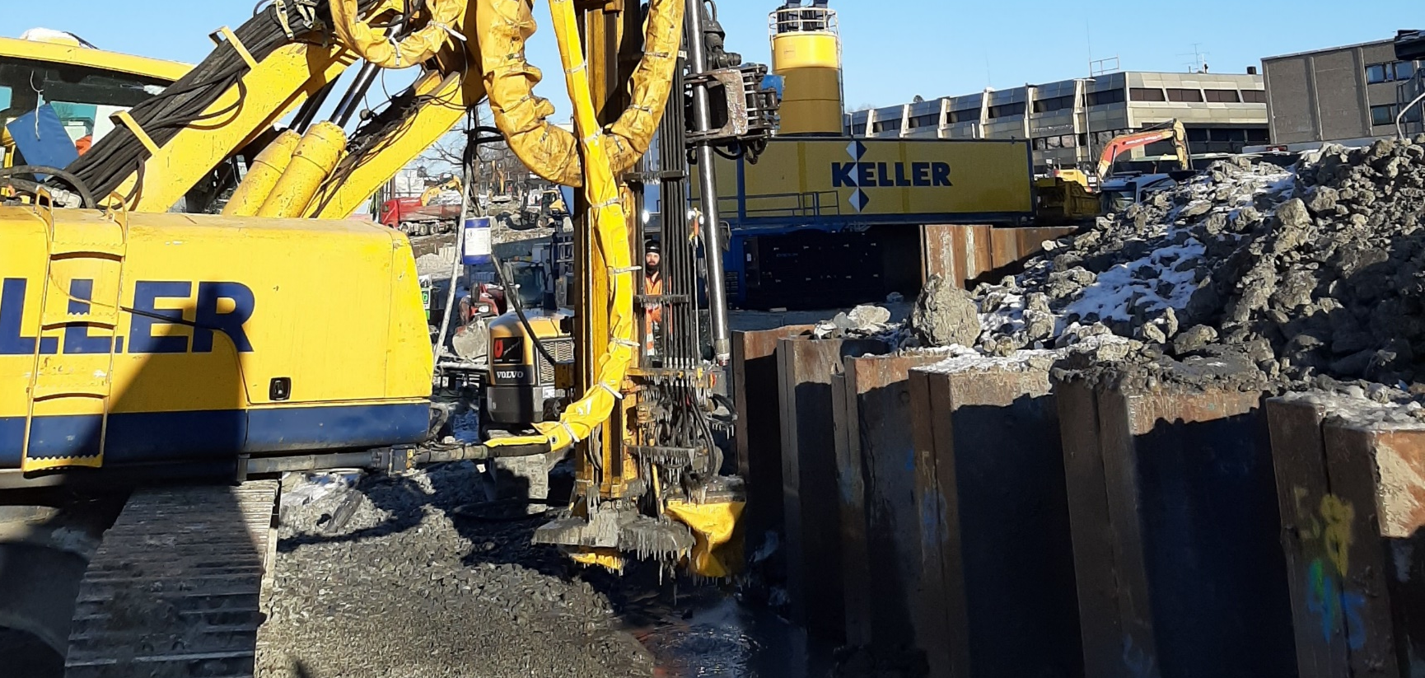
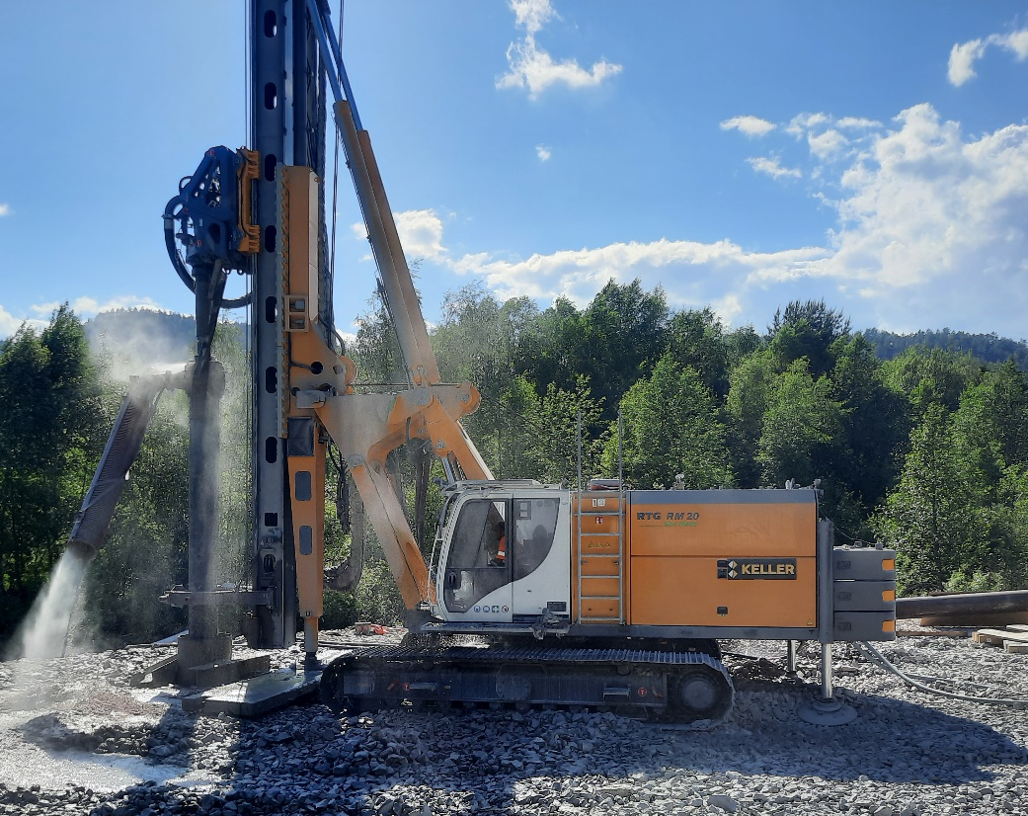
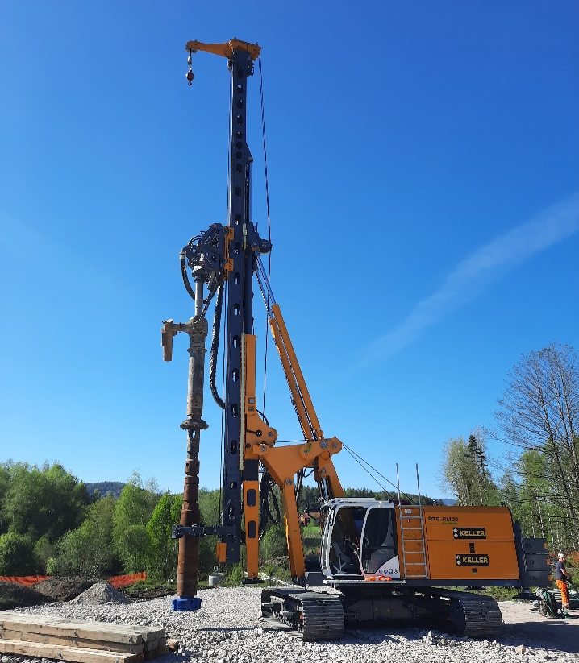
Åse BRU
Bø I Telemark, Norway
Execution of a steel pile foundation with a diameter of 813mm by using the Reverse Circulation drilling method (RC-drilling)
Challenging environmental aspects
Bridge foundation
Piling
The project
  On behalf of the Vestfold and Telemark Fylkeskommune, Morgedal Entreprenør AS has been given responsibility for remediating the Åse bridge. In this regard, there was a need for the establishment of steel pile foundation for the bridge abutment in order to continue the works. The foundation consist of Ø813 mm steel pipes. Keller was contracted by the Morgedal Entreprenør AS to carry out the work during a 10-day summer break.
  The challenge
  Protection of the surrounding area (especially the river)
  Constrained site conditions and environmental requirements
  Drilling depth up to 20m with an 813mm steel pile
  The solution
  The solution to the project was to use Keller's RTG RM20 drilling rig to ensure good progress. The drill rig was equipped with a RC-drilling setup, which ensured that the surrounding area was not harmed by any means of the drill cuttings.
  The casings were drilled up to 20m and a video inspection has been carried out to ensure that the casings have been drilled into hard rock.
  All environmental aspects of the project could be achieved by using the RC-drilling technique which ensured that the drill cuttings could be collected into a given place by the contractor.
Infrastructure
Vestfold og Telemark Fylkeskommune
Morgedal Entreprenør AS
NOK 200.000
Project Manager, Main contractor
Sondre Haugerud +47 96 50 00 09
​
sondre@me-as.no
Project Start:
June 2021
Project End:
June 2021
Keller Geoteknikk AS

