Slide 1
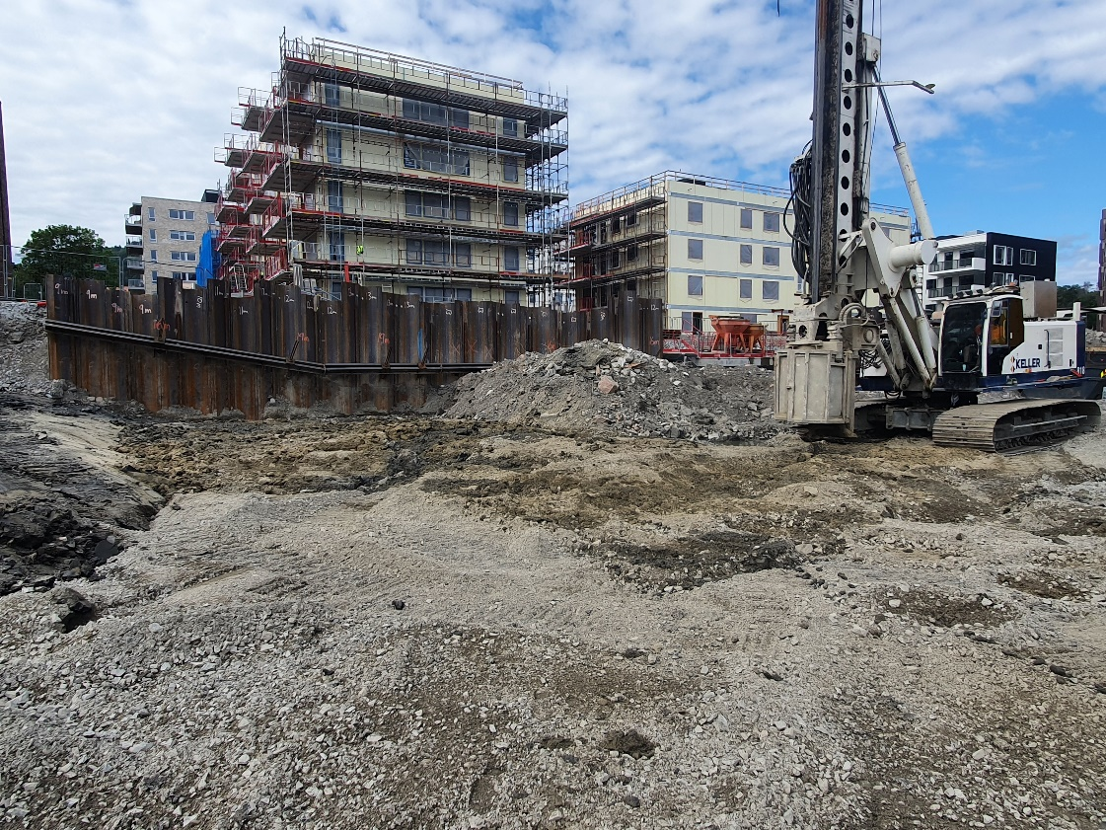
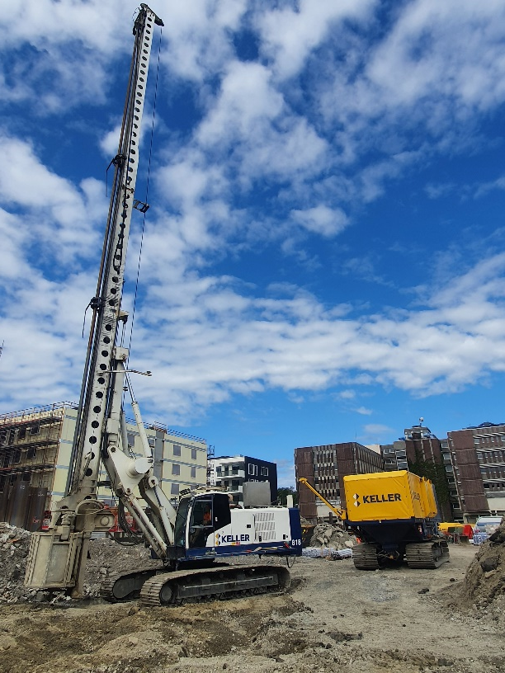
bERGERLØKKA
ASKER
Keller drilled and installed 1 389 lime-cement columns for foundation of new apartments
The work result was 10 000 meters stabilized meters with ø600mm columns
The project
Bergerløkka is located at Billingstad in Asker municipality and is a construction project where JM builds a new apartment complex. The rural area will at the end of the project comprise over 500 attractive apartments close to the Oslo city.
The challenge
The construction site is located in a strongly deformed and folded part of the geological Oslo graben. This gives an oscillating depth to rock, even over short lateral distances. The overlying clay variates also from relatively competent to quick clay.
The solution
All the 1 389 lime-cement columns was drilled down to bedrock. They were installed in a combination of a grid structure and single columns according to the design. 5 individual foundations were made to support some planned elevator shafts.
FKPS testing was also done to ensure the right quality and that the strength was achieved for the treated soil.
Contracting project manager
Espen Skjellestad
espen.skjellestad@jm.no
Project start date: June 2021
Project end date: August 2021

