Slide 1
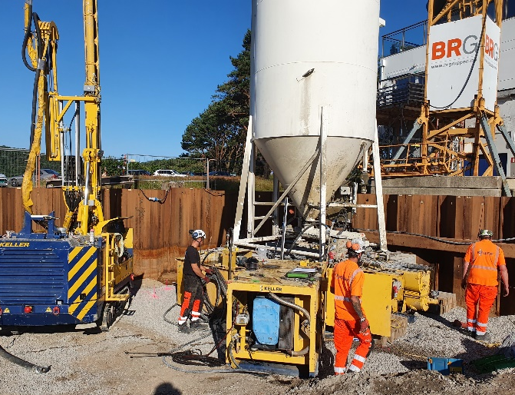
Piren, Mandal
Compaction grouting
Keller installed 51 columns distributed over 12 foundations by compaction grouting to stabilize 2 buildings which faced large settlements
The soil,dominated by sand and silty sand, was treated with compaction grouting as soil improvement measure
The project
BRG Entrepreneur was building new apartments at the seafront in Mandal. Driven concrete piles and steel core piles were installed as foundation of a neighbour building. During this application the two adjacent buildings faced differential settlements exceeding 15 cm.
The challenge
First application of Compaction Grouting in Norway. The foundation of the two adjacent buildings had to be improved before continuing the work on the new building. This had to be a carefully planned operation to prevent further settlements.
The solution
Additional geotechnical investigations were conducted, stating that the loose sand layer is situated 10 to 14 meter below surface. Good communication between the geotechnical designer, the main contractor and Keller Geoteknikk led to the decision of applying compaction grouting to stabilize the settled buildings. Compaction Grouting in combination with live time monitoring was executed on the affected foundations. Vertical displacement in combination with the injected volume and pressure were used as quality control measures. This technique is compacting the surrounding soil by injecting a stiff mortar in stages depending on the present soil conditions. The successful improvement of the soil was confirmed by DPH (heavy dynamic probe) soundings before and after executing the compaction grouting.
Contracting project manager
Fredrik Seyffarth Fredrik.Seyffarth@brgruppen.no
Project start: Juni 2020
Project end: Juli 2020

