Slide 1
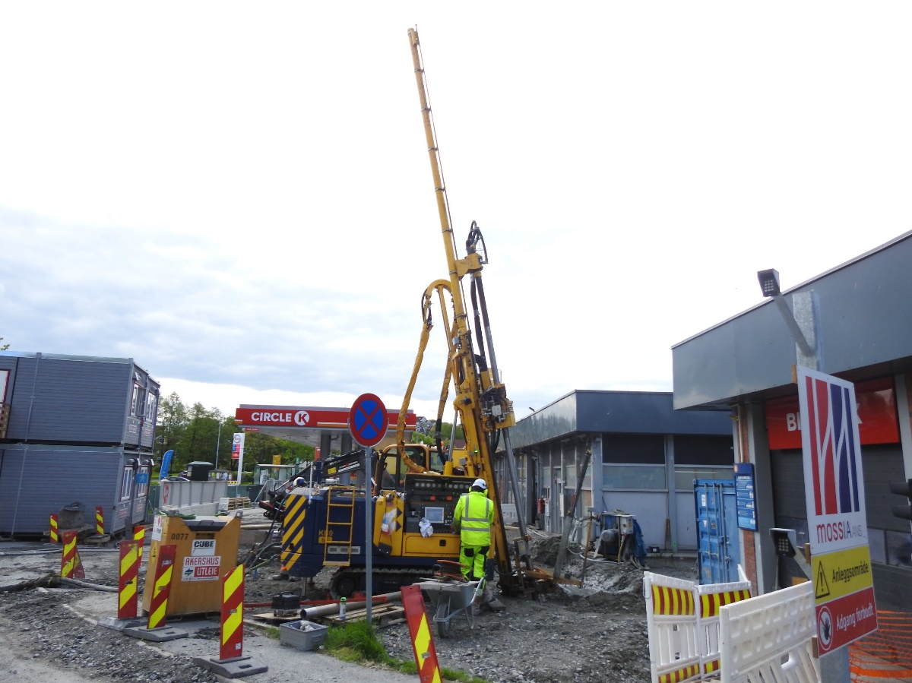
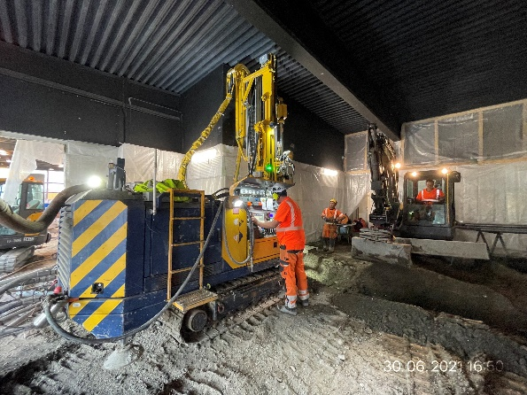
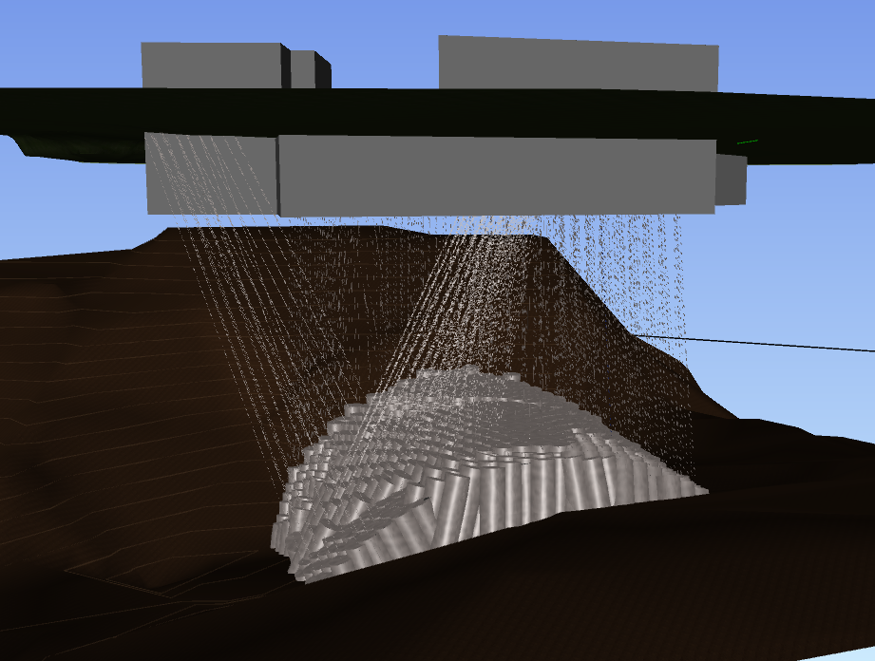
ciRCLE k – sms2a
Treatment of the D&B Tunnel crown from ground surface by means of Jet Grouting. Execution performed up to 30m depth including inclined columns and restricted working height inside the tank station.
Quantities: 593 pcs / 14.366m (Drilling) / 2.994m (JG)
Drilling inclination range from 5° to 25°
Ground improvement
The project
  The SMS2a project is a part of an Intercity development project consisting of 10km new double-track railway. The Circle K section is one part of the six sub-areas within the project. This section sits directly above the new tunnel which will pass through an area of unconsolidated soils and a thin bedrock layer. It is necessary to stabilize this area to prevent subsidence of the soil as tunnel drilling progresses to the city center.
The challenge
  Directional and inclined drilling inside and outside of an existing gas station and utilities, with a tolerance of 2% for deviation
  Low headroom drilling. A clearance height of 4.5m
  Guaranteed overlap of JG columns in the treatment zone and the bedrock interface
  Soil conditions consist of stiff clay, boulders, and moraine. As well as oil contaminated soil.
The solution
  Water drilling with Wassara monitor
  Devico Gyro/Aligner to perform inclined and directional drillings
  Keller rig KB0-5 used for low headroom drilling inside the existing gas station
  Backflow treatment by Keller’s Filterpress to achieve environmental requirements and feasible handling of backflow
Soilcrete^{® -} Jet Grouting
Diameter = 160 cm
UCS = 2 MPa min.
E=450 MPa
Rail / Transportation
Bane Nor
JV Acciona / Implenia (MossIA)
23 022 384 NOK
Contracting Project Director:
Ragnar Reitan
ragnar.reitan@mossia.net
Project start date:
April 2021
Project end date:
September 2021
Keller Geoteknikk AS
Keller Grundbau

